Slide 1

Software Design (swD392)
Ch14 - Designing Object-Oriented Software Architectures

Slide 2
Main Contents
General Introduction
Concepts, Architectures, and Patterns
Designing Information Hiding Classes
Designing Class Interface & Operations
Data Abstraction Classes
State-Machine Classes
Graphical User Interaction Classes
Business Logic Classes
Inheritance in Design
Class Interface Specifications
Detailed Design of Information Hiding Classes
Polymorphism and Dynamic Binding

Slide 3
General Introduction
Object-oriented design refers to software systems that are designed using the concepts of
Information hiding: encapsulate different kinds of information (details of a data structure, state machine,..)
Classes: the design of class interfaces and the operations provided by each class
Inheritance: mechanism for sharing and reusing code between classes - a child class inherits the properties (encapsulated data and operations) of a parent class.
Objects are instantiated from classes & are accessed through operations
Are also referred to as methods
The speciﬁcation and the implementation of a function performed by an object

Slide 4
Concepts, Architectures, and Patterns
Information hiding is a fundamental design concept in which a class encapsulates some information, such as a data structure, that is hidden from the rest of the system
The separation of the interface from the implementation.
The interface forms a contract between the provider of the interface and the user of the interface
These object-oriented concepts have also been applied and extended in the design of
Distributed and component-based software architectures,
Concurrent and real-time software architectures,
Service-oriented architectures,
Software product line architectures.
For communication between objects, the Call/Return pattern is the only pattern of communication in a sequential architecture

Slide 5
Designing Information Hiding Classes
In design modeling, information hiding classes are categorized by stereotype.
Classes determined from the analysis model are categorized as following:
Entity classes from the analysis model, encapsulate data.
Boundary classes Communicate with and interface to the external environment.
Active (concurrent) classes: device I/O classes, proxy classes
Passive boundary classes: graphical user interaction class
Control classes. Provide the overall coordination for a collection of objects.
Control classes are often active (concurrent) classes
One of the passive control classes is the state-machine class, which encapsulates a ﬁnite state machine.
Application logic classes.
Encapsulate application-specific logic and algorithms
Categorized as business logic classes, service classes, or algorithm classes.

Slide 6
Designing Class Interface & Operations
The class interface consists of the operations (methods) provided by each class.
Each operation can have input parameters, output parameters, and (if it is a function) a return value.
The operations of a class can be determined typically from the dynamic model
Interaction message: operations being invoked at the destination object receiving the message
Message passing between passive objects consists of an operation in one object invoking an operation provided by another object
From the class diagrams of the static model: standard operations are create, read, update, delete (CRUD actions)

Slide 7
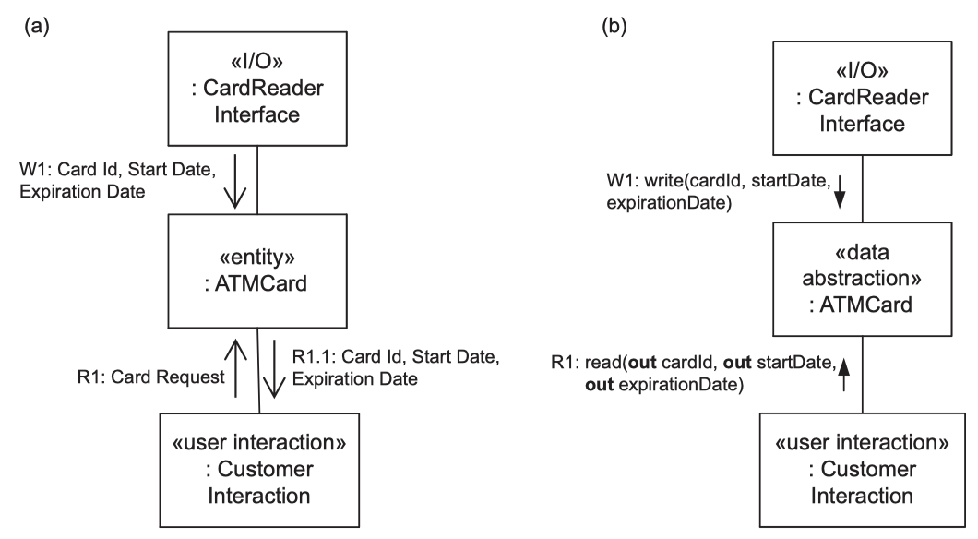
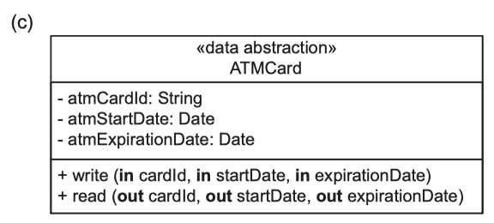
Designing Class Interface & Operations Designing Class Operations from the Interaction Model
(a) Analysis model: communication diagram.
(b) Design model: communication diagram.
(c) Design model: class diagram
Notes:
By examining the analysis model communication diagram (a), it can be seen that the Card Reader Interface object sends three data items: Card Id, Start Date, and Expiration Date (previously read off the ATM Card) to be stored in the ATM Card entity object. The Customer Interaction object later sends a Card Request message to ATM Card, which returns these same three data items.
During design, the precise class interface is designed. Because these three data items are written to ATM Card, in the design model (b), an operation of the ATM Card data abstraction object called write is designed, which has three input parameters (cardId, startDate, and expirationDate). The Card Request message sent by Customer Interaction is designed as a read operation provided by ATM Card. The three data items returned by ATM Card are designed to be output parameters (cardId, startDate, and expirationDate) returned by the read operation. The operation calls are depicted, using the UML synchronous message notation.
After the object’s operations have been determined from the communication diagram, the operation is speciﬁed in the static model, together with the class that provides the operation (c)

Slide 8
Data Abstraction Classes
Used to encapsulate the data structure
Hiding the internal details of how the data structure is represented
The operations are designed as access procedures or functions whose internals, which deﬁne how the data structure is manipulated, are also hidden.
Each entity class in the analysis model that encapsulates data is designed as a data abstraction class.
An entity class stores some data and provides operations to access the data and to read or write to the data.
In the data abstraction class
The information on the attributes information should be available from the static model of the problem domain
The operations of the data abstraction class are determined by considering the needs of the client objects that use the data abstraction object in order to indirectly access the data structure. This can be determined by analyzing how the data abstraction object is accessed by other objects, as given in the communication model.

Slide 9
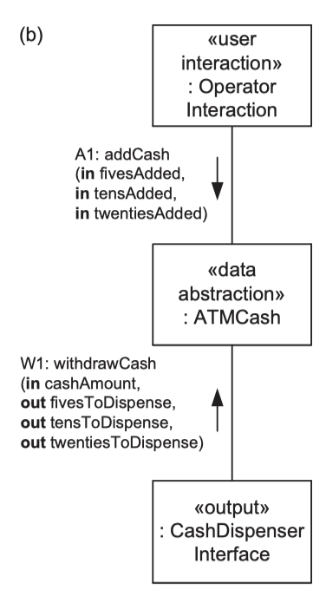

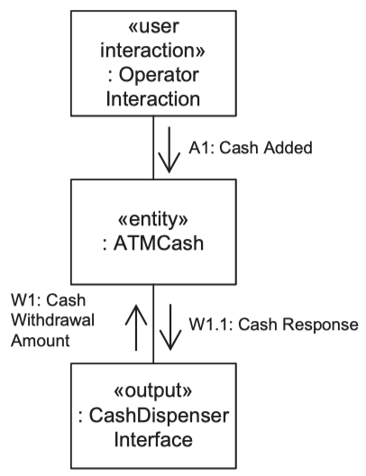
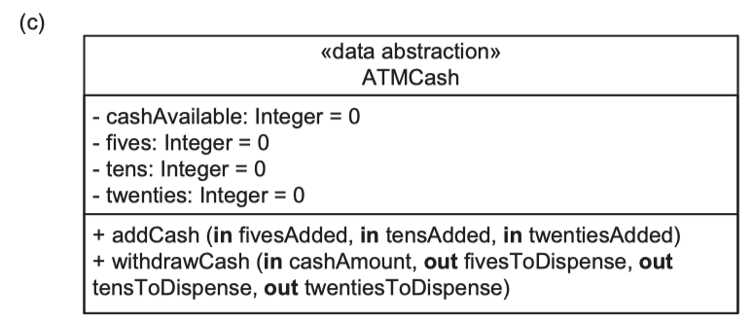
Data Abstraction Classes
Notes:
The communication diagram in the analysis model (a): consists of two objects that need to access the ATM Cash data abstraction object.
The attributes of ATM Cash are given in the static model.
ATM Cash stores the amount of cash maintained by the ATM cash dispenser, in twenty-, ten-, and ﬁve-dollar bills;
Therefore, it has internal variables to maintain the number of ﬁve-dollar bills, the number of ten-dollar bills, and the number of twenty-dollar bills.
Based on this, an ATM Cash class is designed that encapsulates four variables – cashAvailable, ﬁves, tens, and twenties – whose initial values are all set to zero.
In addition to knowing what messages are sent to ATM Cash, it is also important to know the sequence in which the messages are sent.
When ATM Cash receives a Cash Withdrawal Amount message from the Cash Dispenser Interface object, containing the amount in dollars to be dispensed, it needs to compute how many bills of each denomination need to be dispensed to satisfy the request. ATM Cash sends this information in a response message, Cash Response.
ATM Cash receives another kind of message from the Operator Interaction object. The real-world ATM operator replenishes (bổ sung) the ATM cash dispenser with new dollar bills of each denomination. This information needs to be stored in ATM Cash. After adding the cash to the dispenser, the operator conﬁrms this to the Operator Interaction object, which then sends a Cash Added message to the ATM Cash object
From the previous discussion, the operations of the ATM Cash class can be speciﬁed, as depicted in the Design Model communication diagram shown in (b)
The class interface (depicted in (c)) consists of the public operations, addCash and withdrawCash,and the parameters of the operations:

Slide 10
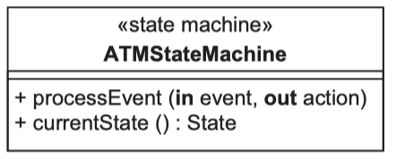
State-Machine Classes
During class design, the state-machine class determined in the analysis model is designed.
The statechart executed by the state-machine object is encapsulated in a state transition table. Thus, the state-machine class hides the contents of the state transition table and maintains the current state of the object
State-machine classes provide the operations that access the state
transition table & change
the state of the object.
Notes:
One or more operations are designed to process the incoming events that cause state changes
One way of designing the operations of a state-machine class is to have one operation for each incoming event

Slide 11
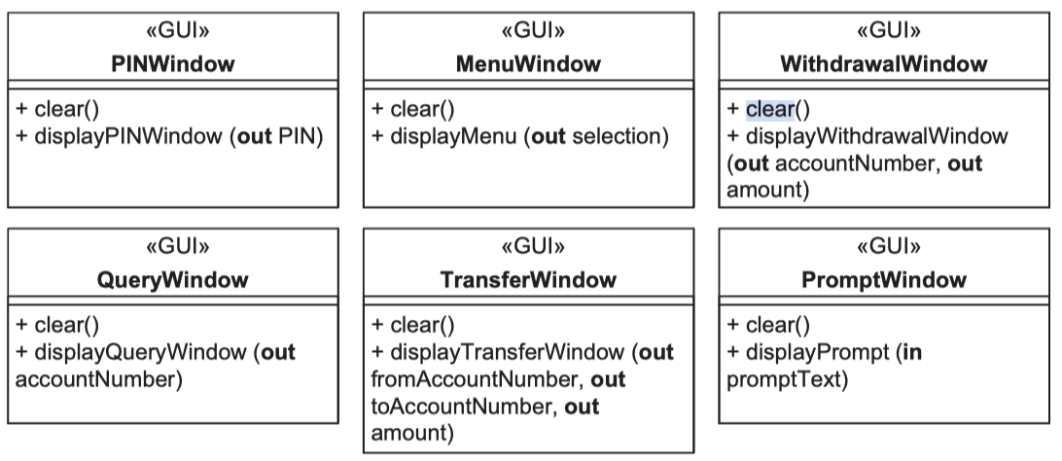
Graphical User Interaction Classes
A graphical user interaction (GUI) class hides from other classes the details of the interface to the user.
In a given application, the user interface might be a simple command line interface or a sophisticated GUI
A command line interface is typically handled by one user interaction class.

Slide 12
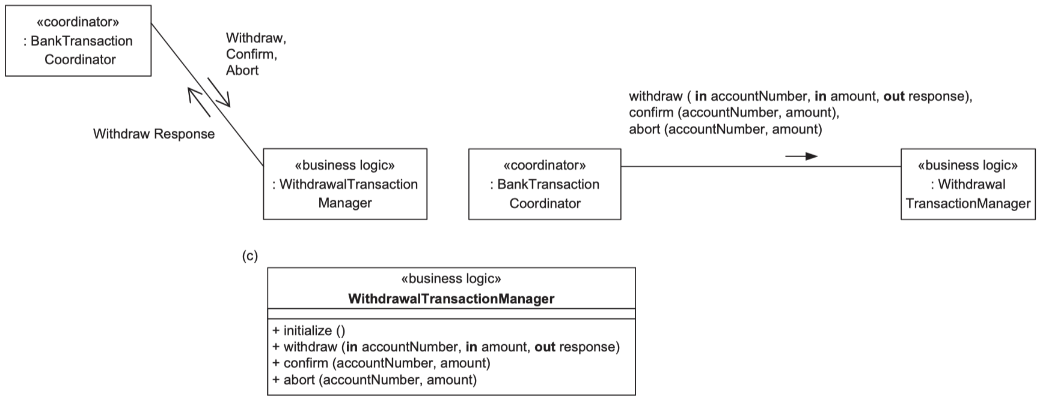
Business Logic Classes
A business logic class defines the decision-making, business-specific application logic for processing a client’s request. The goal is to encapsulate business rules that could change independently of each other into separate business logic classes.
Usually a business logic object accesses various entity objects during its execution.
Notes:
The business logic class Withdrawal Transaction Manager encapsulates the rules for processing an ATM withdrawal request. It has operations to initialize, withdraw, conﬁrm, and abort.
The operation initialize is called at initialization time;
withdraw is called to withdraw funds from a customer account;
conﬁrm is called to conﬁrm that the withdrawal transaction was successfully completed;
abort is called if the transaction was not successfully completed (e.g., if the cash was not dispensed at the ATM)

Slide 13
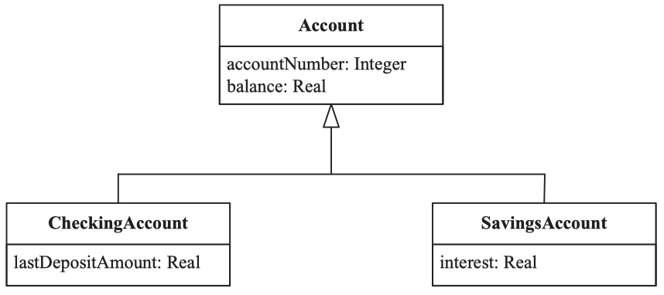
Inheritance in Design
Inheritance can be used when designing two similar, but not identical, classes (share many, but not all, characteristics).
Inheritance can also be used when adapting a design for either maintenance or reuse purposes.
Class Hierarchies
Class hierarchies (also referred to as generalization/specialization hierarchies and inheritance hierarchies) can be developed either top-down, bottom-up, or by some combination of the two approaches.
When designing with
inheritance, the internals
of the parent classes
are visible to the subclasses
Notes:
Checking Account: tài khoản thanh toán / vãng lai
Both checking and saving accounts need account-Number and balance attributes
One requirement for checking accounts is that it is desirable to know the last amount deposited in the account.
On the other hand, in this bank, savings accounts accrue interest but checking accounts do not.

Slide 14
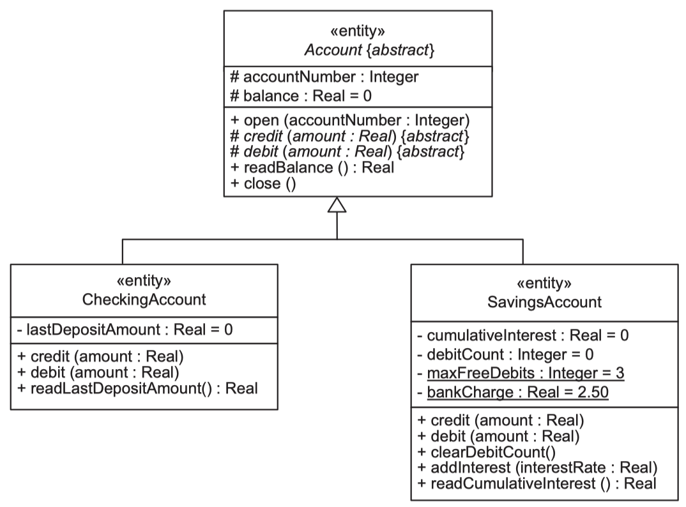
Inheritance in Design Abstract Classes
An abstract class is a class with no instances, used as a template to create subclasses
An abstract operation is an operation that is declared in an abstract class but not implemented.
In reality, some of the operations may be implemented in the abstract class, especially in
cases in which some or all
of the subclasses need to
use the same
implementation.
Notes:
We need to know the accumulated interest on a savings account, so the attribute cumulativeInterest is declared as an attribute of the Savings Account subclass.
In addition, only three debits are allowed per month from a savings account without a bank charge, so the attribute debitCount is also declared as an attribute of the Savings Account subclass.
Both Checking Account and Savings Account will need the same operations as the Account class – namely, open, close, readBalance, credit, and debit.
The credit and debit operations are handled differently for checking and savings accounts
For Checking Account: debit ~ deduct amount from balance; credit ~ increment balance by amount and then set lastDepositAmount equal to amount.
For Savings Account: credit ~ increment balance by amount; debit ~ debiting the balance && increment debitCount && deduct bankCharge for every debit in excess of maxFreeDebits. There is also a need for an additional clearDebitCount operation, which reinitializes debitCount to zero at the end of each month.
At ﬁrst glance, the read operations for checking and savings accounts appear to be identical; however, a more careful examination reveals that this is not the case. When we read a checking account, we wish to read the balance and the last deposit amount. When we read a savings account, we wish to read the balance and the accumulated interest. The solution is to have more than one read operation

Slide 15
Class Interface Specifications
A class interface specification defines the interface of the information hiding class, including the specification of the operations provided by the class. It defines the following:
Information hidden by information hiding class: for example, data structure(s) encapsulated, in the case of a data abstraction class.
Class structuring criteria used to design this class.
Assumptions made in specifying the class: for example, whether one operation needs to be called before another.
Anticipated changes. This is to encourage consideration of design for change.
Superclass (if applicable)
Inherited operations (if applicable)
Operations provided by the class. For each operation, define:
Function performed
Precondition (a condition that must be true when the operation is invoked)
Postcondition (a condition that must be true at the completion of the operation)
Invariant (a condition that must be true at all times: before, during, and after execution of the operation)
Input parameters
Output parameters
Operations used from other classes

Slide 16
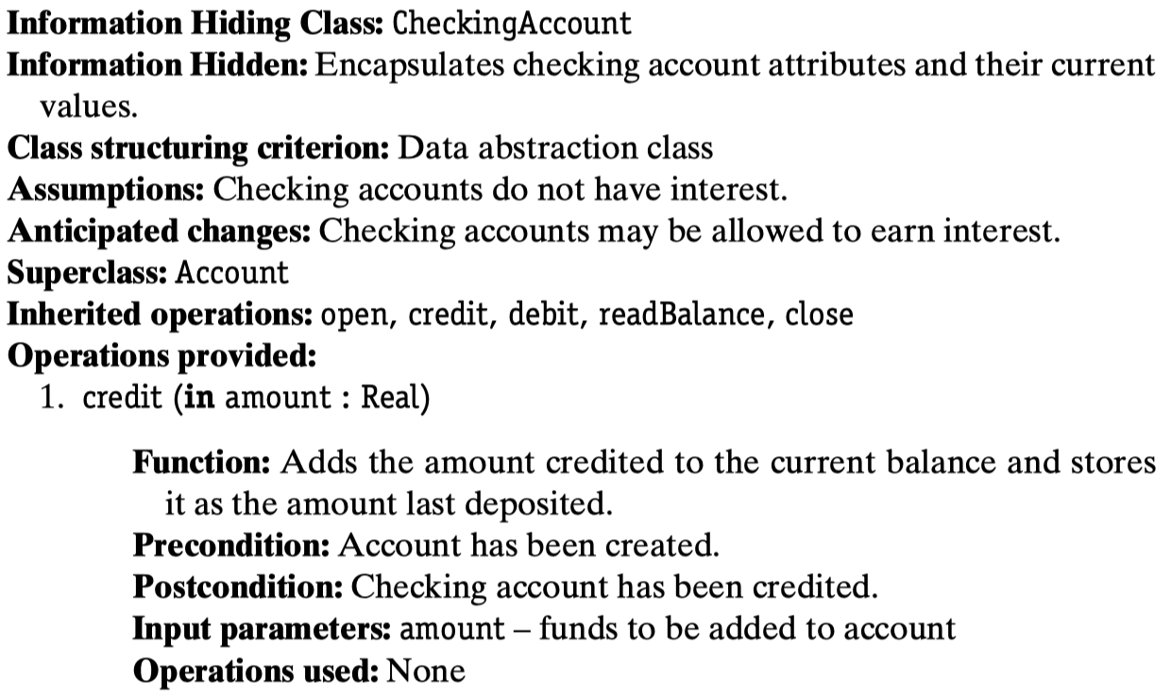
Class Interface Specifications Example of Class Interface Speciﬁcation 1/2

Slide 17
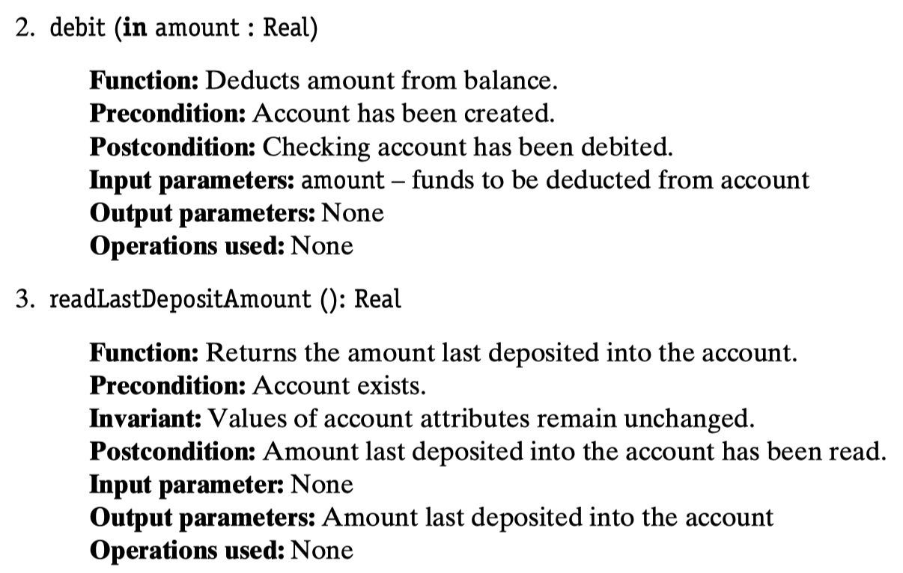
Class Interface Specifications Example of Class Interface Speciﬁcation 2/2

Slide 18
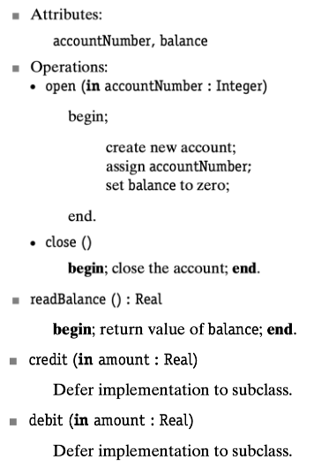
Detailed Design of Information Hiding Classes
During detailed design of the information hiding classes, the internal algorithmic design of each operation is determined. The operation internals are documented in pseudocode.
Detailed Design of the Account
Abstract Superclass

Slide 19
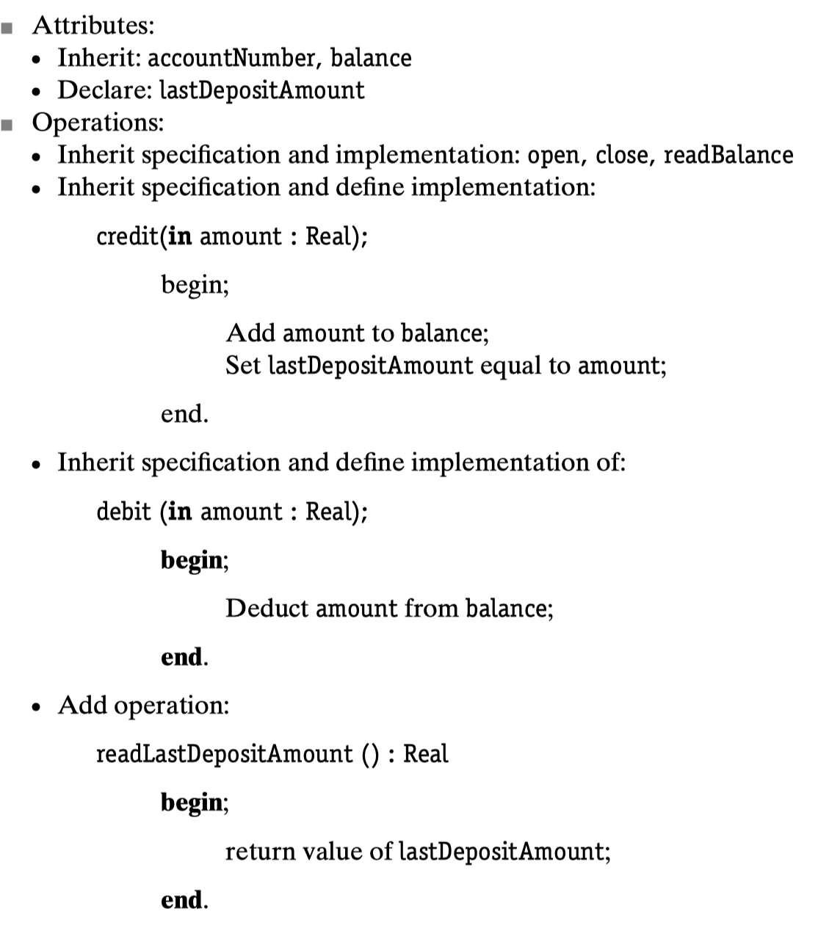
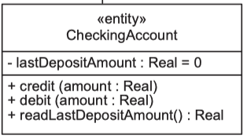
Detailed Design of Information Hiding Classes
Detailed Design of
Checking Account
Subclass

Slide 20
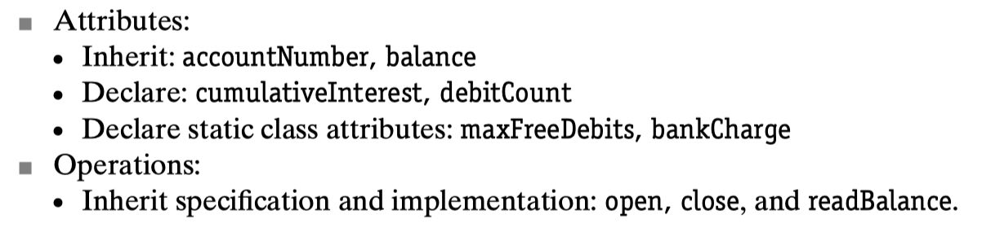
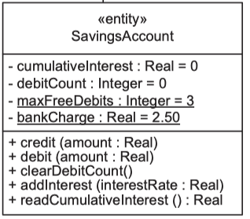
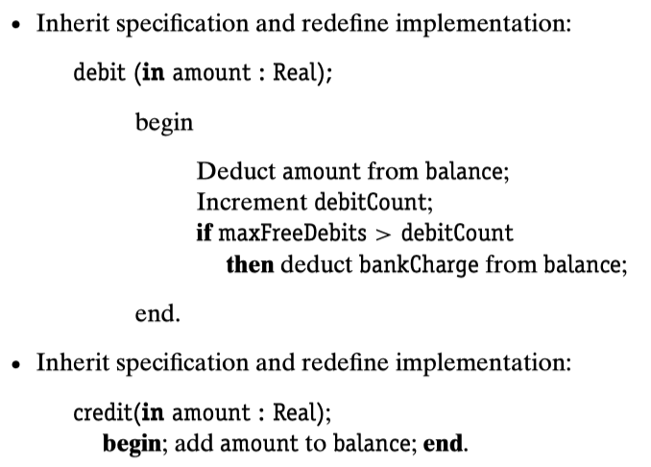
Detailed Design of Information Hiding Classes
Detailed Design of
Savings Account
Subclass 1/2

Slide 21
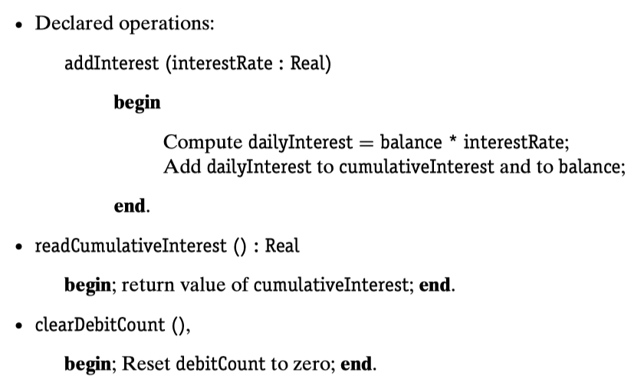
Detailed Design of Information Hiding Classes
Detailed Design of
Savings Account
Subclass 2/2

Slide 22
Polymorphism and Dynamic Binding
Polymorphism is Greek for “many forms”. In object-oriented design, polymorphism is used to mean that different classes may have the same operation name. The specification of the operation is identical for each class; however, classes can implement the operation differently.
Dynamic binding is used in conjunction with polymorphism.
Dynamic binding means that the association of a request to an object’s operation is done at run-time and can thus change from one invocation to the next.
Notes:
Conjunction: kết hợp
Invocation: sự mời mọc

Slide 23
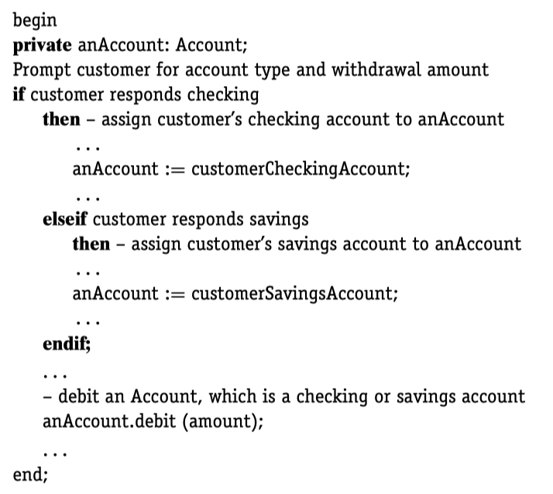
Polymorphism and Dynamic Binding
Example of Polymorphism and Dynamic Binding
Notes:
Conjunction: kết hợp
Invocation: sự mời mọc

Slide 24


